Slide 1
8/27 Progress Report
Topic : Thesis review by SVM
Thesis : Predicting the Treatment Outcomes of Antidepressants
Using a Deep Neural Network of Deep Learning in
Drug-Naïve Major Depressive Patients

Slide 2
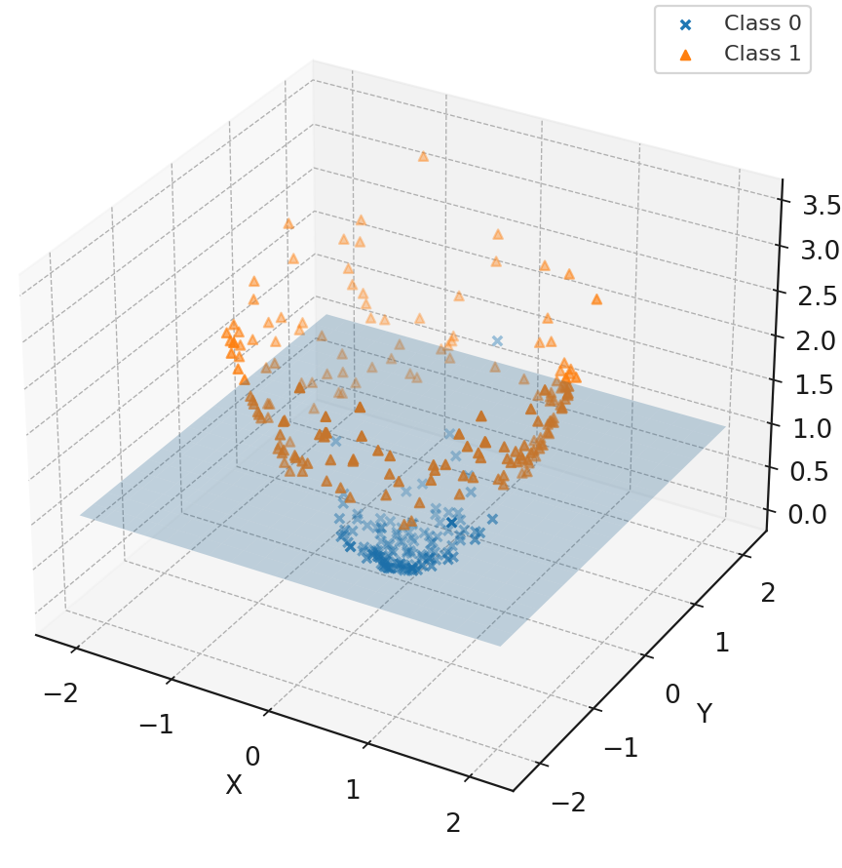
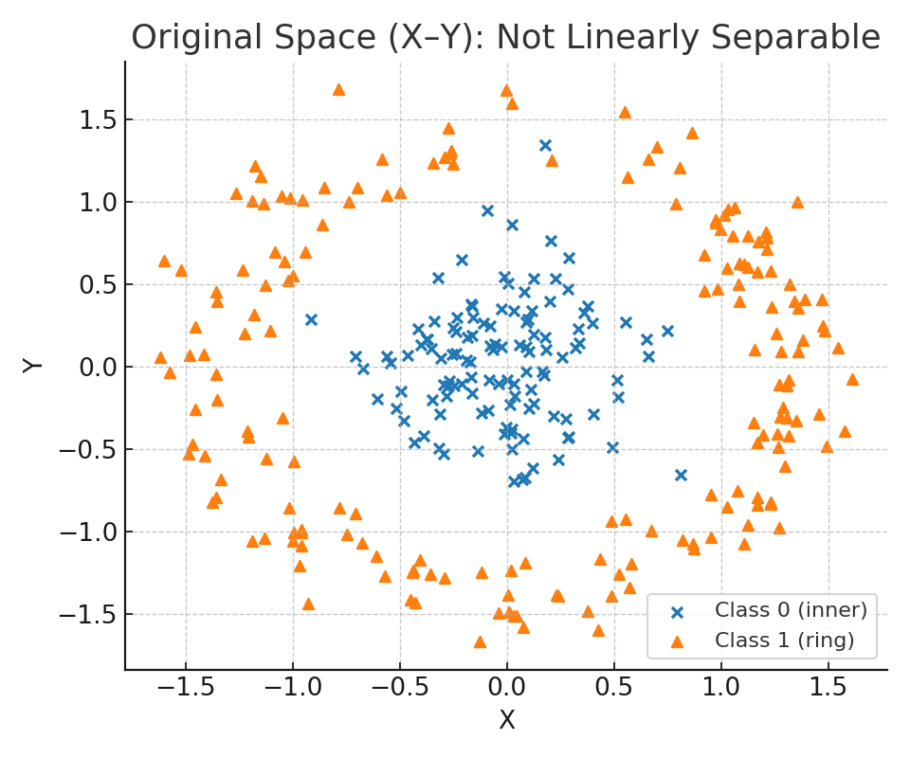
How does SVM work ?
SVM 如何處理分類問題
參數設定 & 資料處理
Standardization : StandardScaler, MinMaxScaler, RobustScaler, Normalizer
Kernel : Linear, Polynomial, RBF, Sigmoid
gamma(γ) : 決策邊界影響範圍 (邊界平滑程度)
C : 懲罰係數

Slide 3
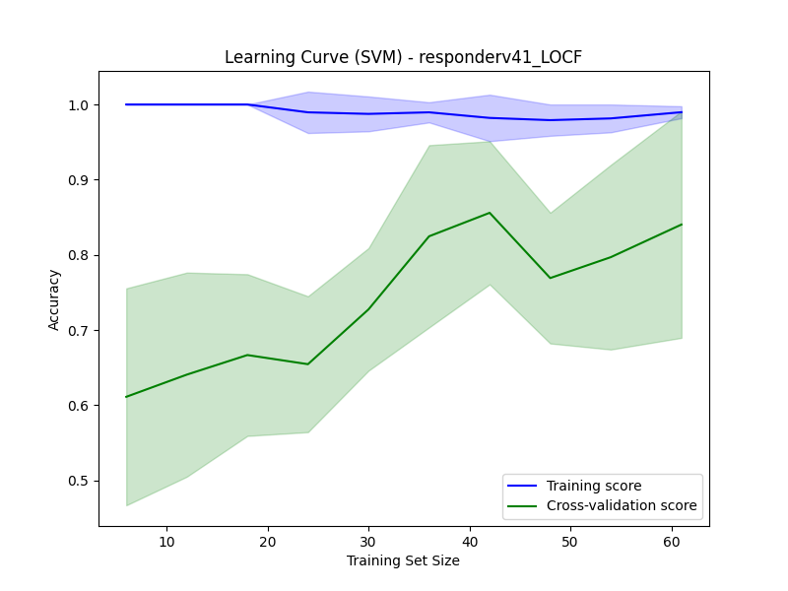
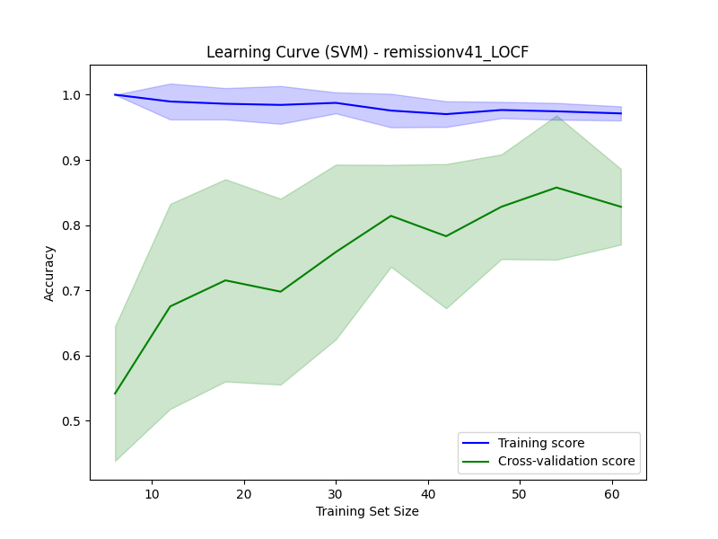
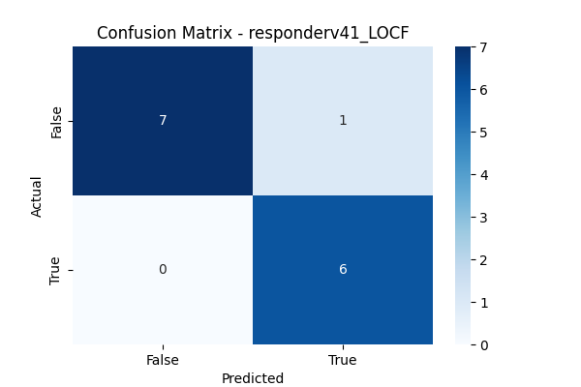
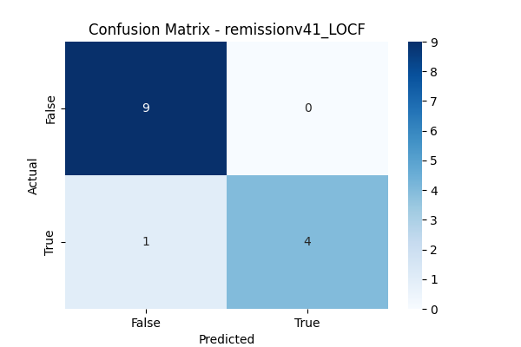
Basic value
Model : SVM (kernel - RBF)
cross validation : 8 – fold
Remission Accuracy: 0.8420 ± 0.0856
Responder Accuracy: 0.9010 ± 0.1105
Accuracy: 0.8214 ± 0.1713
Fine – tuning Status
Preprocessing : MinMaxScaler
C : 65
Gamma : 0.005
Final Accuracy
Remission AUC: 0.8933 ± 0.1355
Responder AUC: 0.9333 ± 0.0649
Remission : 0.9286 (13 / 14)
Responder : 0.9286 (13 / 14)
Responder – learning rate
Remission – learning rate
Responder – confusion matrix
Remission – confusion matrix

Slide 4
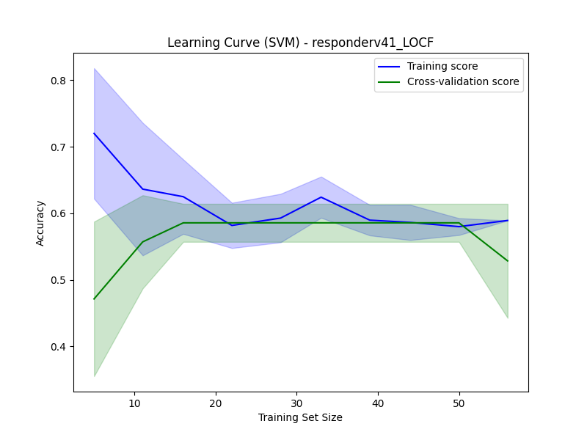
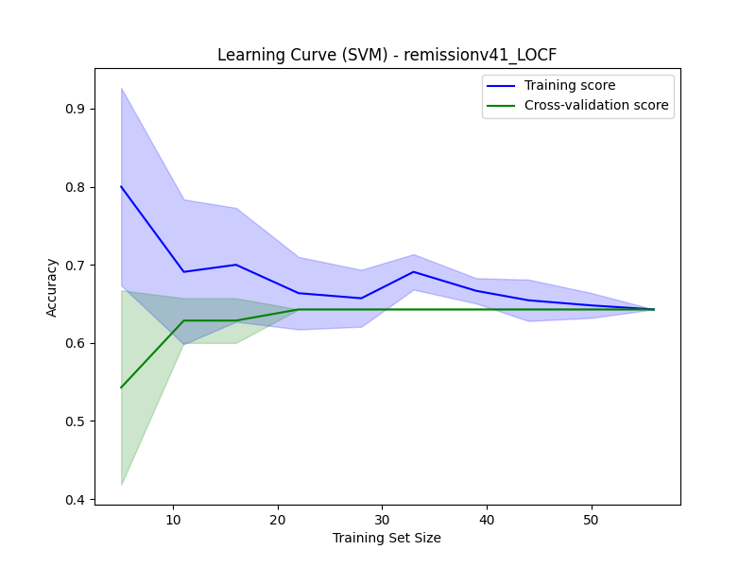
Drug v.s. Responder & remission
Basic value
Model : SVM (kernel - RBF)
cross validation : 5 – fold
Remission Accuracy: 0.6429 ± 0.0000
Responder Accuracy: 0.5857 ± 0.0319
Importance : 0.00 ± 0.00
Fine – tuning Status
C : 1
Gamma : scale
Final Accuracy
Remission AUC: 0.4622 ± 0.0877
Responder AUC: 0.4708 ± 0.0669
Remission : 0.6429
Responder : 0.5714
Responder – learning rate
Remission – learning rate

Slide 5
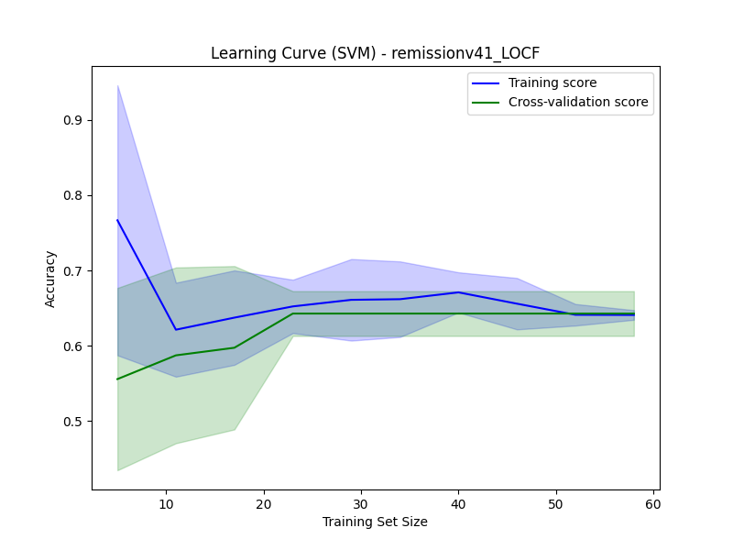
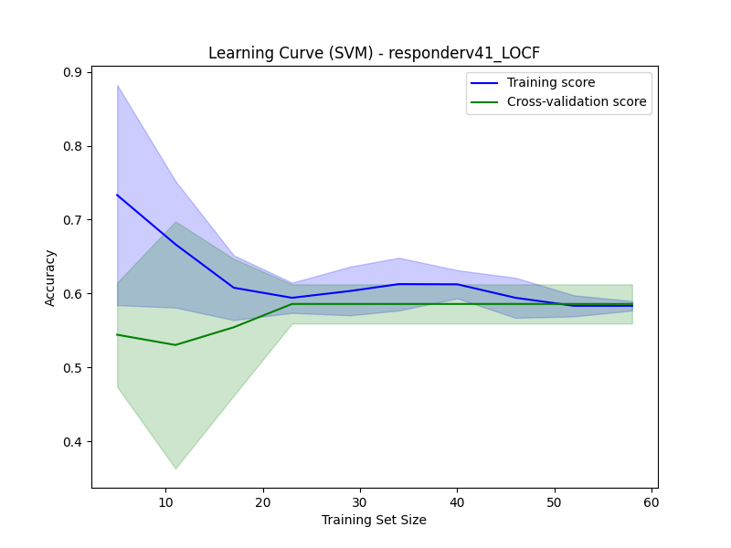
Drug v.s. Responder & remission with Linear kernel
Basic value
Model : SVM (kernel - Linear)
cross validation : 6 – fold
Remission Accuracy: 0.6427 ± 0.0326
Responder Accuracy: 0.5164 ± 0.1738
Fine – tuning Status
C : 0.9
Gamma : scale
Final Accuracy
Remission AUC: 0.5467 ± 0.0837
Responder AUC: 0.5414 ± 0.0725
Remission : 0.6429
Responder : 0.5714
Remission – learning rate
Responder – learning rate

Slide 6
Follow up - Feature Importance
Positive Importance
HAMD_V4_LOCF (治療至第六周的 HAMD 分數) => 0.421± 0.101
oxytocin_LOCF (催產素) => 0.083 ± 0.049
pers_err_LOCF (WCST Perseverative errors) => 0.083 ± 0.032
SSS.iib_s (Received routine social support) => 0.080 ± 0.057
whoqol28_ov (WHOQoL - Overall)=> 0.076 ± 0.060
Negative Importance
GNB3G (Gene) => -0.035 ± 0.035
Age (年紀) => -0.016 ± 0.054
HbA1c_LOCF (糖化血色素 /血糖控制狀況) => -0.009 ± 0.024
P – value:
HAMD : 0.242
Oxytocin : 0.039*
pers_err : 0.718
SSS : 0.047*
WHOQoL : 0.015*
GNB3G : 0.459
Age : 0.754
HbA1c : 0.398
Notes:
怎麼測試各feature重要程度:打亂後測試30次 HAMD:漢米爾頓憂鬱量表
WCST Perseverative errors:威斯康辛卡片分類測驗持去錯誤

Slide 7
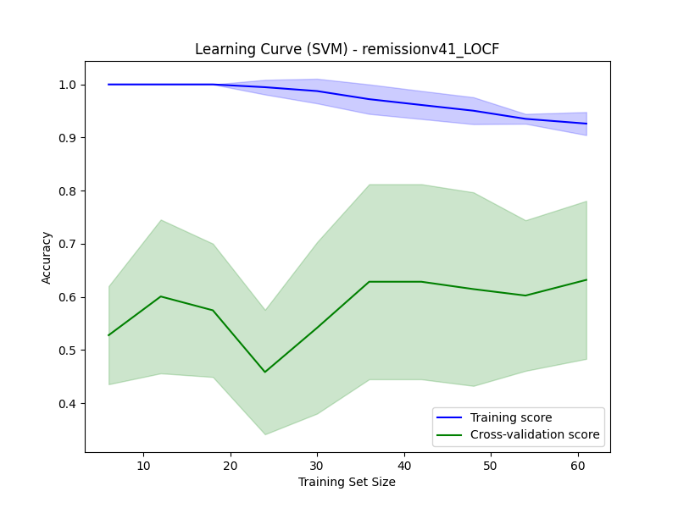
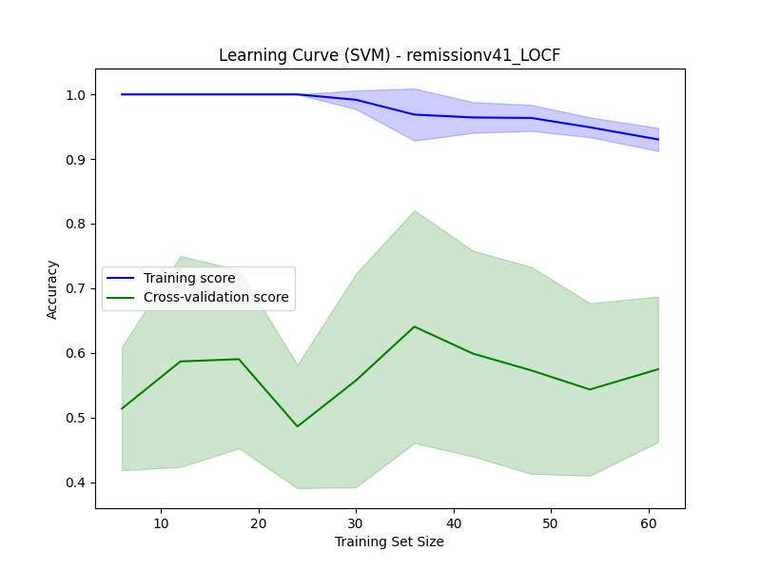
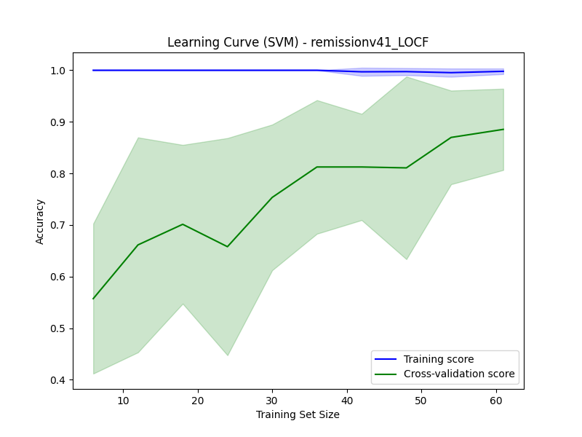
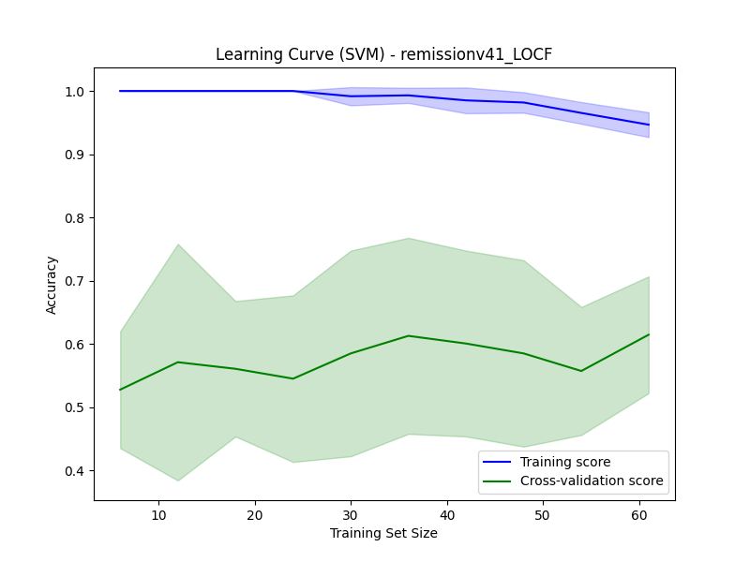
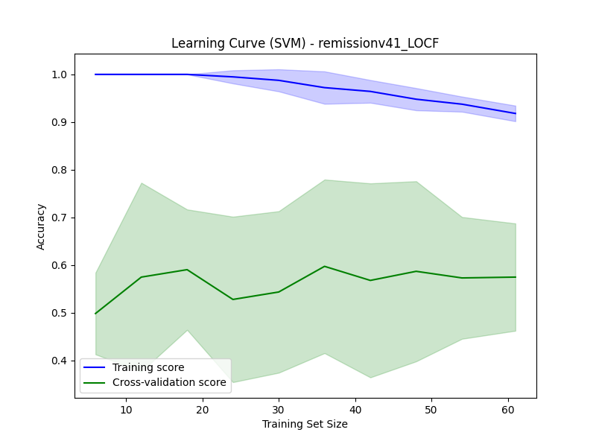
Testing Feature Importance
oxytocin_LOCF
Accuracy: 0.6071 ± 0.2835
SSS.iib_s
Accuracy: 0.5357 ± 0.1713
Describe :
Remove the top five features in feature importance one by one, and then evaluate the model’s subsequent performance.
The results show that, except for the model with HAMD_V4_LOCF removed, the other four models exhibit poor predictive performance. This verifies the critical importance of HAMD_V4_LOCF for this model.
HAMD_V4_LOCF
Accuracy: 0.7857 ± 0.0714
whoqol28_ov
Accuracy: 0.5179 ± 0.1587
pers_err_LOCF
Accuracy: 0.5179 ± 0.2468

Slide 8
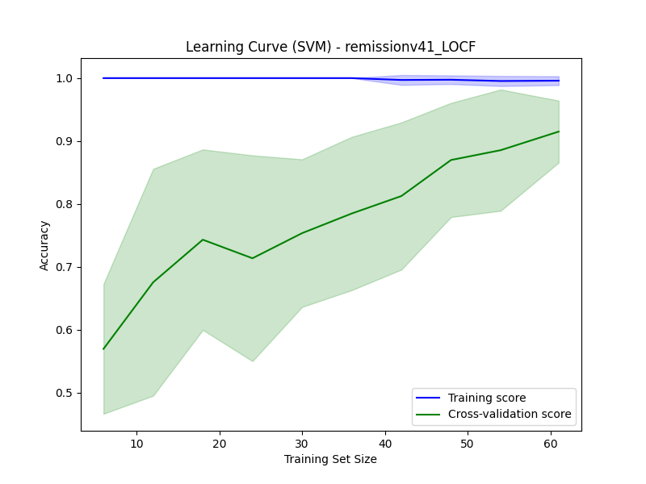
Excluding all Negatively Correlated Features
Basic value
Model : SVM (kernel - RBF)
cross validation : 8 – fold
Remission Accuracy: 0.9167 ± 0.0985
Responder Accuracy: 0.8872 ± 0.1030
Accuracy Score : 0.8214 ± 0.1185
Fine – tuning Status
Preprocessing : MinMaxScaler
C : 180
Gamma : 0.008
Excluding Negatively dataset v.s. Entire dataset
Accuracy Score : 0.8214 v.s. 0.8214
Standard Deviation of Accuracy : 0.1185 v.s. 0.1713 (gain 45%)
Entire dataset – learning rate
Excluding Negatively dataset – learning rate

Slide 9
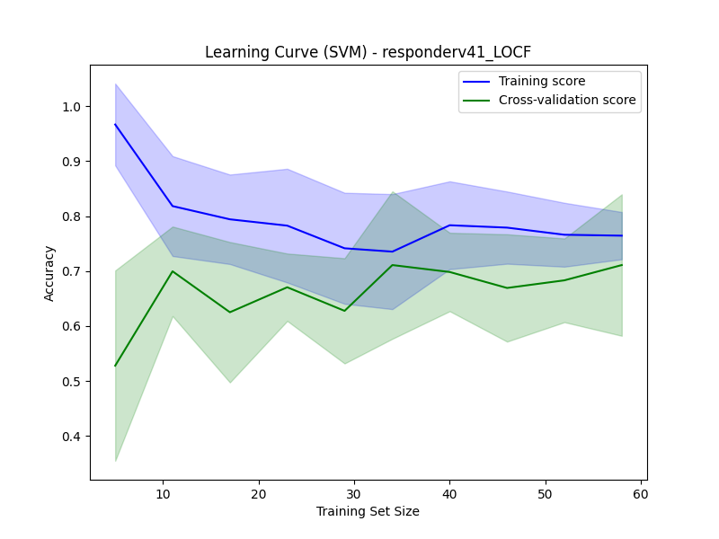
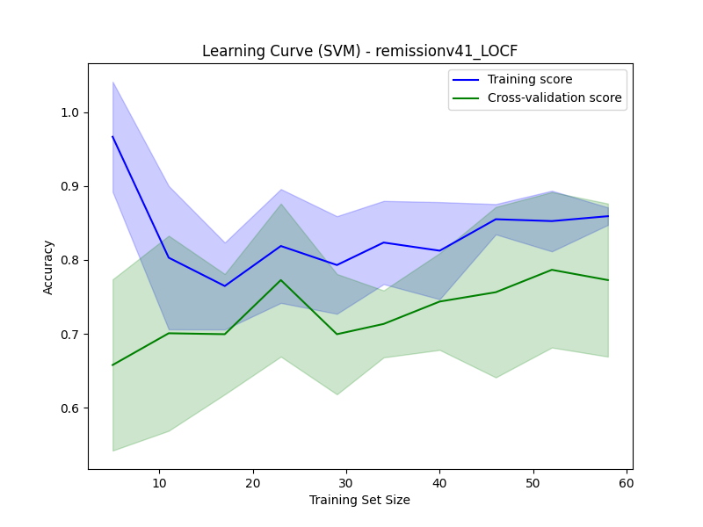
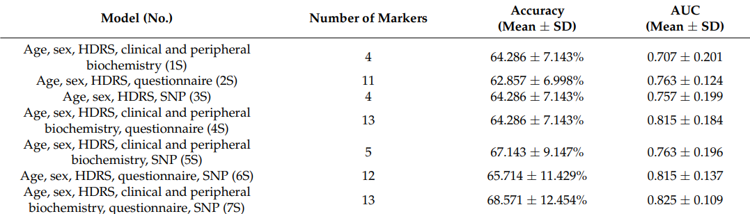
Compare with reference
6 - fold
Remission Accuracy: 0.8119 ± 0.0930
Responder Accuracy: 0.6869 ± 0.0965
Remission AUC: 0.8710 ± 0.0685
Responder AUC: 0.7167 ± 0.1086

